Slide 1
SENTIMENT ANALYSIS OF DRUG REVIEWS
Team Members:
Sai Saketh Aluru -- 16CS30030
PVSL Hari Chandana -- 16CS30026
Potnuru Anusha -- 16CS30027
K Sai Surya Teja -- 16CS30015

Slide 2
Problem Statement
To classify review of a drug as positive, neutral or negative using sentiment analysis.
Analyse the classification using different machine learning based and deep learning based models using in-domain and non-domain embeddings, and comparing their performances.

Slide 3
Motivation
The field of medical science in continuously improving with new drugs coming up everyday.
Patients present their opinions about drugs on various platforms.
Sentiment analysis results of drug reviews plays a very important role in determining
The effectiveness and public opinions of the drug
what drugs are preferred by people for a particular condition
about any potential side effects, etc.

Slide 4
Introduction
Sentiment analysis: The process of computationally identifying and categorizing opinions expressed in a piece of text.
Sentiment analysis is often used for understanding:
Key aspects of a brand’s product and service that customers care about.
Users’ underlying intentions and reactions concerning those aspects.
NLP plays an important role in analyzing millions of brand conversations available on social media forums and understanding the basic social sentiment present in them.

Slide 5
Dataset
Drug Review Dataset (Drugs.com) Data Set is used for this task.
The dataset provides patient reviews on specific drugs along with related conditions and a 10-star patient rating reflecting overall patient satisfaction. The data was obtained by crawling online pharmaceutical review sites.
Attribute Information present in the dataset: drugName (categorical), condition (categorical), review, rating (numerical), date, usefulCount (numerical).
The dataset consists of 161297 training samples and 53766 test samples.

Slide 6
Data Preprocessing
Balanced Training Dataset: Generated a training dataset with equal number of samples in all the three classes.
Review Preprocessing: Stop words, unnecessary punctuations have been removed. Care has been taken so as to not remove words containing negativity in them such as wouldn’t, hadn’t etc. The number of sentences and words per sentence in the reviews are made constant sized by zero padding wherever necessary.
Coarse Grain Labels: The 10 classes have been mapped into 3 class labels such that 1-4 are labelled ‘negative’, 5-6 as ‘neutral’ and 7-10 as ‘positive’.

Slide 7
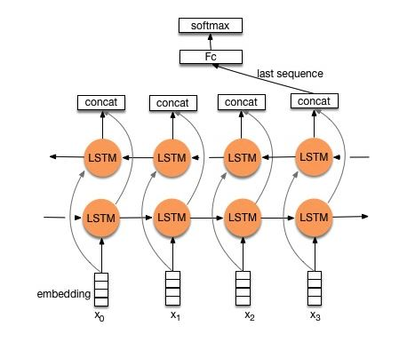
TextRNN
RNNs can be used to make predictions, or to learn from sequential data and generate similar data.
Using pre-trained embeddings can enhance the precision of RNN because it integrates new information about the words.

Slide 8
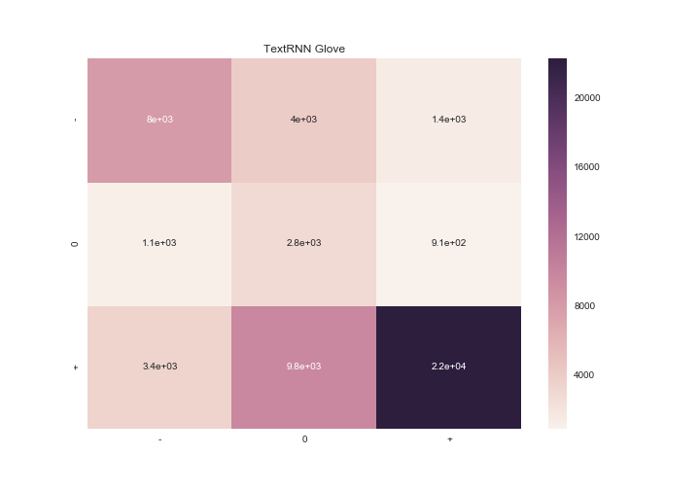
TextRNN Results
Using Glove 6B 50d word embeddings:
Accuracy: 0.62
F1 score: 0.67
Sentiment | Precision | Recall | F1-Score | Support
0 | 0.64 | 0.60 | 0.62 | 13497
1 | 0.17 | 0.59 | 0.26 | 4829
2 | 0.90 | 0.63 | 0.74 | 35440

Slide 9
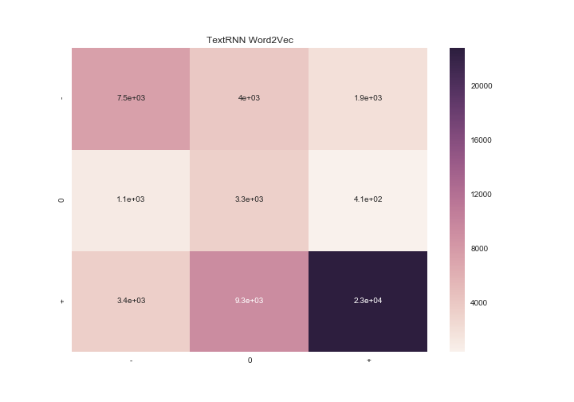
Using Word2vec embeddings trained on Google News corpus.
Accuracy: 0.63
F1-score: 0.68
Sentiment | Precision | Recall | F1-Score | Support
0 | 0.63 | 0.59 | 0.61 | 13497
1 | 0.20 | 0.69 | 0.31 | 4829
2 | 0.91 | 0.64 | 0.75 | 35440

Slide 10
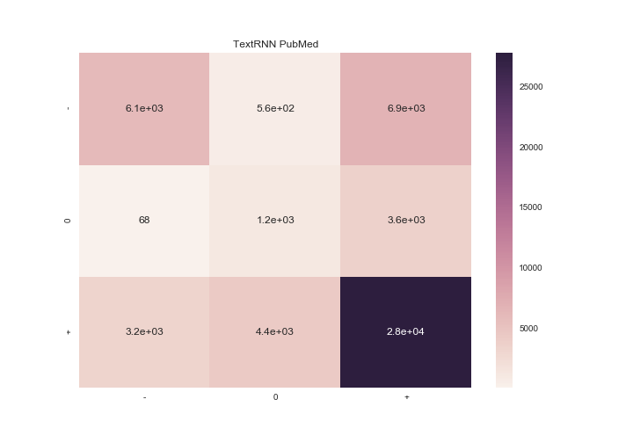
Using Pubmed in-domain embeddings:
Accuracy: 0.65
F1 score: 0.64
Sentiment | Precision | Recall | F1-Score | Support
0 | 0.65 | 0.45 | 0.54 | 13497
1 | 0.22 | 0.25 | 0.24 | 4829
2 | 0.72 | 0.78 | 0.74 | 35440

Slide 11
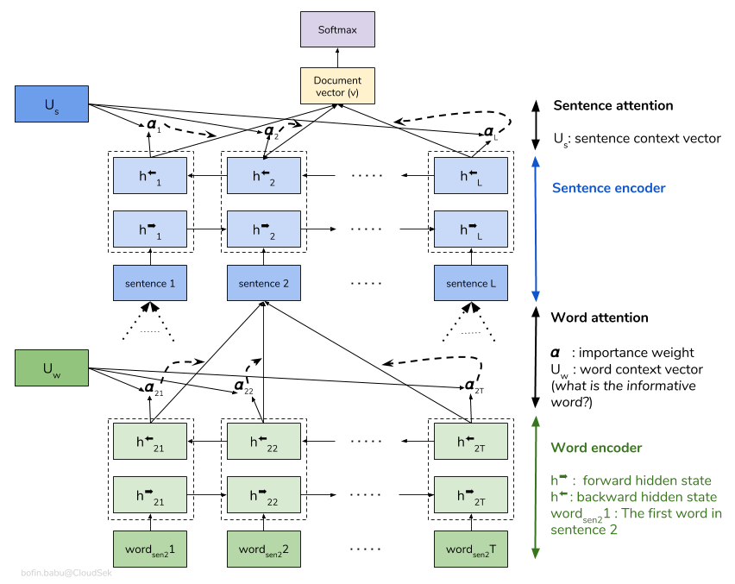
Hierarchical Attention Network
HAN uses stacked RNN on word level followed by attention model. It extracts words that are important to the meaning of the sentence and aggregate their representation to form a sentence vector.
The same procedure is then applied to the derived sentence vectors which generates a vector conceiving the meaning of the given document.

Slide 12
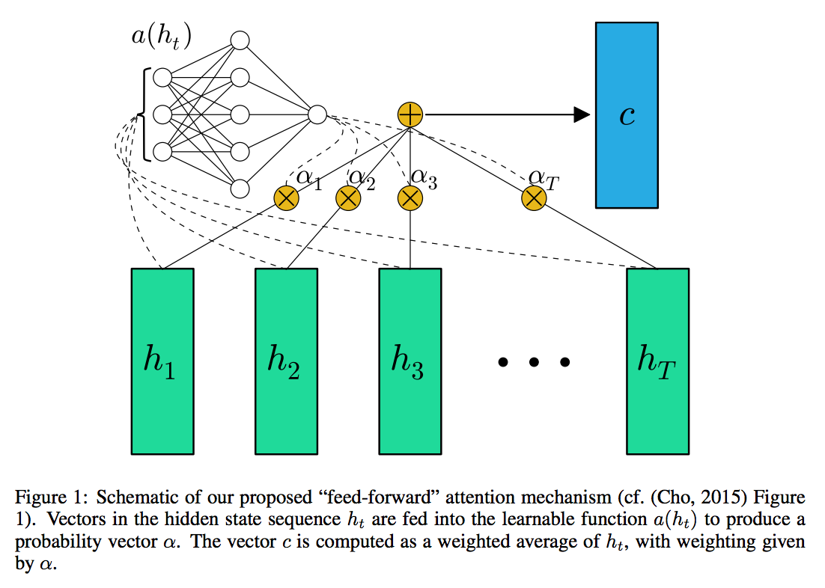
Attention model used in HAN
The vectors from Bidirectional RNN pass through shallow neural network to decide weight corresponding to each vector. The weighted sum of each vector embodies the meaning of those vectors combined.

Slide 13
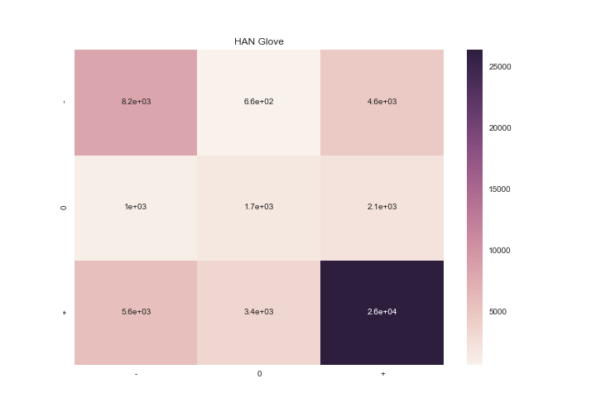
HAN Results
Using Glove 6B 50d word embeddings:
Accuracy: 0.67
F1-score: 0.67
Sentiment | Precision | Recall | F1-Score | Support
0 | 0.55 | 0.61 | 0.57 | 13497
1 | 0.29 | 0.35 | 0.31 | 4829
2 | 0.80 | 0.74 | 0.76 | 35440

Slide 14

Using Word2vec embeddings trained on Google News corpus.
Accuracy: 0.65
F1-score: 0.65
Sentiment | Precision | Recall | F1-Score | Support
0 | 0.56 | 0.55 | 0.55 | 13497
1 | 0.26 | 0.32 | 0.30 | 4829
2 | 0.75 | 0.74 | 0.74 | 35440

Slide 15
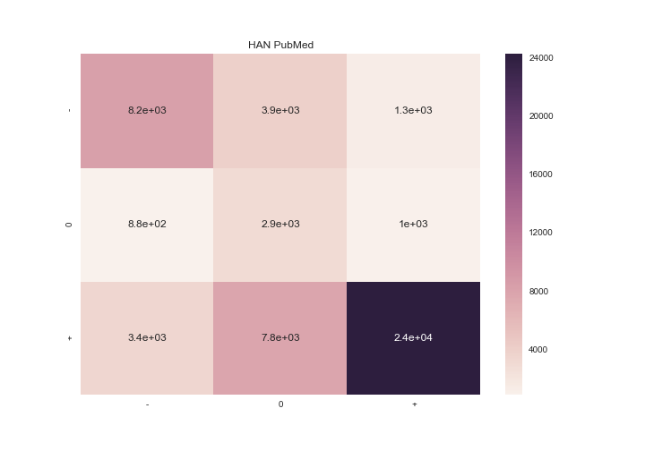
Using Pubmed in-domain embeddings:
Accuracy: 0.66
F1-score: 0.70
Sentiment | Precision | Recall | F1-Score | Support
0 | 0.66 | 0.61 | 0.63 | 13497
1 | 0.20 | 0.59 | 0.30 | 4829
2 | 0.92 | 0.68 | 0.78 | 35440

Slide 16
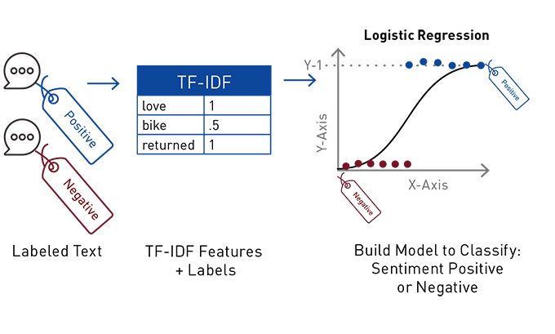
ML Baselines - Logistic Regression
We have used TF-IDF weighting where words that are unique to a particular document would have higher weights compared to words that are used commonly across documents.

Slide 17
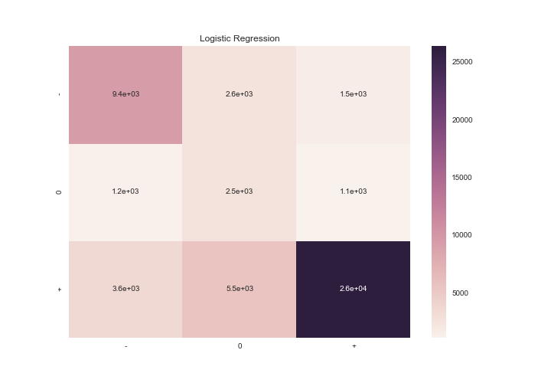
Logistic Regression Results
Accuracy is 71.31272551426552
F1-score is 0.74
Sentiment | Precision | Recall | F1-Score | Support
0 | 0.66 | 0.70 | 0.68 | 13497
1 | 0.24 | 0.53 | 0.33 | 4829
2 | 0.91 | 0.74 | 0.82 | 35440

Slide 18
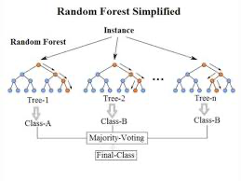
ML Baselines - Random Forest
Random Forest Classifier is an ensemble of a large number of individual decision trees.
Each individual tree is trained on a random sample of the training data and spits out a class prediction.
The class with the most votes becomes our model’s prediction

Slide 19
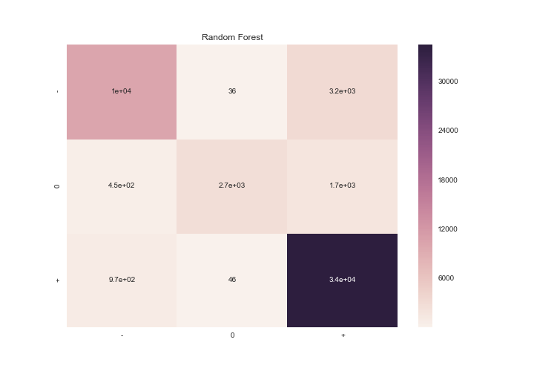
Random Forest Results
Accuracy is 88.0593683740654
F1-score is 0.87
Sentiment | Precision | Recall | F1-Score | Support
0 | 0.87 | 0.76 | 0.81 | 13497
1 | 0.97 | 0.57 | 0.72 | 4829
2 | 0.88 | 0.97 | 0.92 | 35440

Slide 20

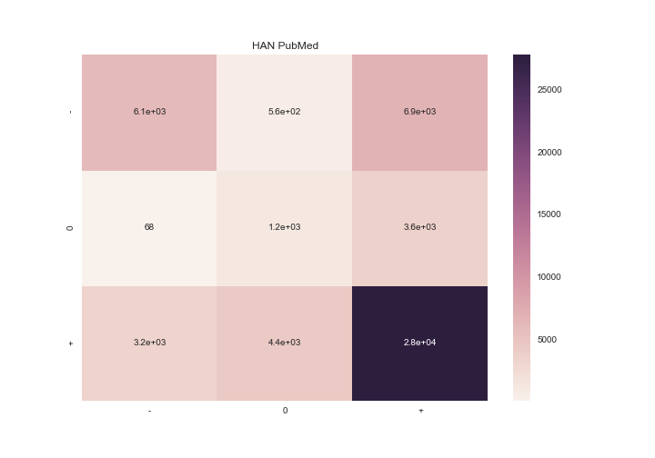
TextRNN
HAN
GloVe
Word2Vec
PubMed

Slide 21
Observations
Comparison of training time: ML models(5mins) vs TextRNN(1hour) vs HAN(6 hours) Glove < Word2Vec < PubMed Performance of different models: TextRNN < HAN < ML models
Performance of different embeddings: Glove ~ Word2vec ~ Pubmed
Prediction accuracy of different classes: Neutral < Negative < Positive

Slide 22
Ablation Analysis
Decoding reviews with sarcasm: “The medicine is so good it makes me sleep all day.”
This is a negative review for a general medicine, which is expressed using positively inclined words like ‘good’ in a sarcastic setting.
But this same review could also be an ambiguous review for sleeping medicine.
In-domain vectors: We observe that the usage of these in-domain embedding vectors has little to no effect on the model performance. This is mostly due to the fact that the general public post reviews in simple, layman terms and seldom use biomedical terminology.

Slide 23
Ablation Analysis
Analysis of TextRNN vs HAN:
Processing review as sequential in TextRNN vs Hierarchical structure in HAN
The performance of HAN is observed to be slightly better than TextRNN model on an average. This is expected, due to the added hierarchy in the model, and the use of attention in the classification process.
Relatively lower performance for neutral class: Positive and negative classes can often be predicted using target words such as ‘best’ and ‘worst’. But such strong emotions are often not expressed in neutral class and hence hard to classify.

Slide 24
Ablation Analysis
Why Random Forest works the best? Machine learning models use tf-idf vectors(product of counts and inverse document frequency) and hence have knowledge specific to the dataset, whereas, deep learning models work on individual reviews.
Dataset bias: The drug reviews are posted by patients and don’t categorize as standardized samples, as they may contain bias.

Slide 25
Examples
"I am a 22 year old female college student. I wanted to write this because when I was at my lowest of low when I felt absolutely hopeless... these positive reviews are what got me through the day. I experienced a lot of change. I was also in a relationship that made me unhappy. I stopped doing the things I liked to do such as run, party, work, hang out with friends etc. In result, I never had energy. I constantly felt guilty. I cried everyday, sometimes multiple times of day. I went to group therapy. I dropped 10lbs in two weeks. I eventually got on this medicine; the first 4 days felt crazy tired! TAKE AT NIGHT. Give this medicine time! Now 3 weeks in I am back to myself and am truly happy! Keep your head up."
This is an review from positive class, predicted as negative class due to lot of negative words.

Slide 26
Examples
"Yes, this medication does work wonders, at first. Diagnosed ADHD (by a Psychiatrist) at the age of 26. The first 3 years it worked quite well and felt like a godsend. I took 5-6 days a week and my life demonstratively improved. Focus, completing tasks, mental clarity, improved self-esteem...life was good.
Adderall, like other CNS stimulants, tend to become less effective after time and I noticed this more pronouncedly by my 5th year. The problem was that even after a month or more without Adderall, none of discontinuation symptoms were improving. While I continue to use Adderall for maintenance, I derive little benefit. Be aware, the effects won’t last indefinitely!"
This is an example of negative class and predicted as positive due to lot of positive words.

Slide 27
Conclusion
In this project, we have analyzed the performance of multiple models using different embeddings for the task of sentiment analysis of drug reviews
After analyzing these performances, we conclude that having global knowledge of the dataset helps the model in preventing confusions.

Slide 28
THANK YOU!

